Slide 1

beatr
Android app for creation and
composition of electronic music

Slide 2
beatr what?
+ invent melodies & loops wherever you are
+ sketch beats right in your Android smart phone/tablet
+ features a synth, a bass
& a programmable drum machine
+ fade loops in/out with the mixr to create transitions and compose longer melodies
+ designed to work with low end Android devices

Slide 3
technical details
+ everything is implemented on
top of an MVC (Model View Controller) framework
+ 6500 LOC distributed over ~70 classes
+ low amounts of circular dependencies
thanks to the eclipse plugin STAN (code analyzer)
+ uses a software synthesizer (Pure Data) Android port, which relies on NDK (Native Development Kit) to write
audio data straight to the sound card using C.
Android SDK currently lacks this functionality.
+ Pure Data is available in many languages
and for many platforms, check it out!

Slide 4
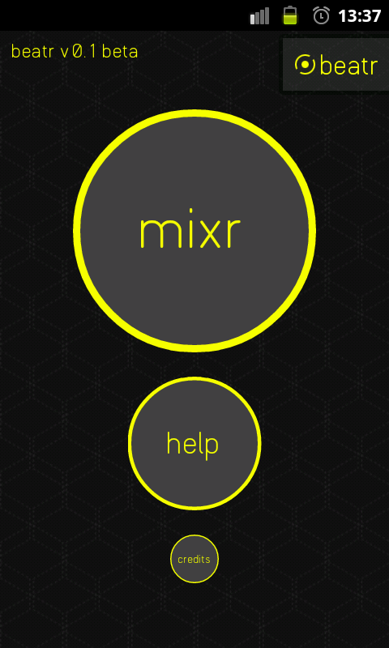
the app – main menu
+ features the beatr theme
(logo + background) which is
used throughout the app
+ important buttons are larger
+ works as a welcome screen
+ the help and credit views
are just basic images & texts,
no point in showing them here

Slide 5
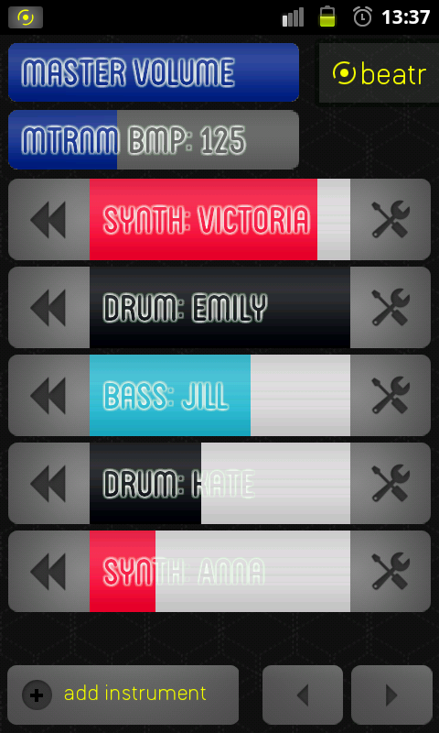
the app – mixer
+ master volume –
affects all instruments
+ instruments featured in a list
< > navigates the list of instruments
+ metronome – set the
beats per minute
+ possible to rewind a recorded
instrument loop
+ possible to set the volume of individual instruments
+ the button with tools on it
launches the instrument’s editor

Slide 6
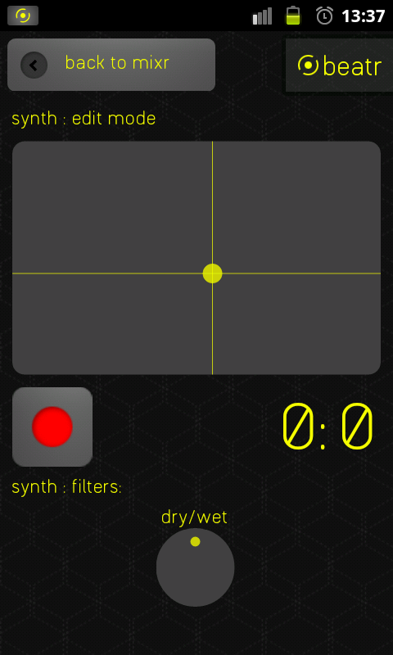
the app – synth & bass editors
+ the synth & bass instruments
are basically the same, just
different pitches (synth high,
bass low)
+ XY-slider controls the pitch
and controls a setting that makes the sound more distant/dull
+ record what you are doing, whatever you record will keep playing when you go back
to the mixer

Slide 7
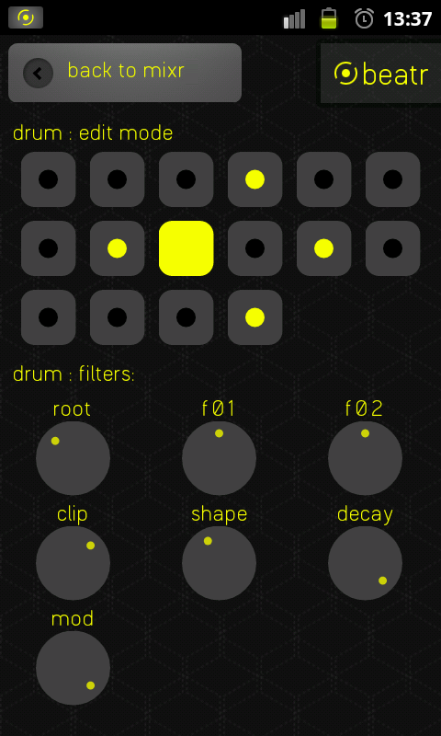
the app – drum editor
+ features 16 drum pads, which
can be turned on (yellow dot in the middle) or off (black dot)
+ when the metronome beats, the drum machine moves to play the next drum pad (full yellow pad).
+ no option to record, it just keeps running
+ 7 filters (decay and root are the most interesting)

Slide 8
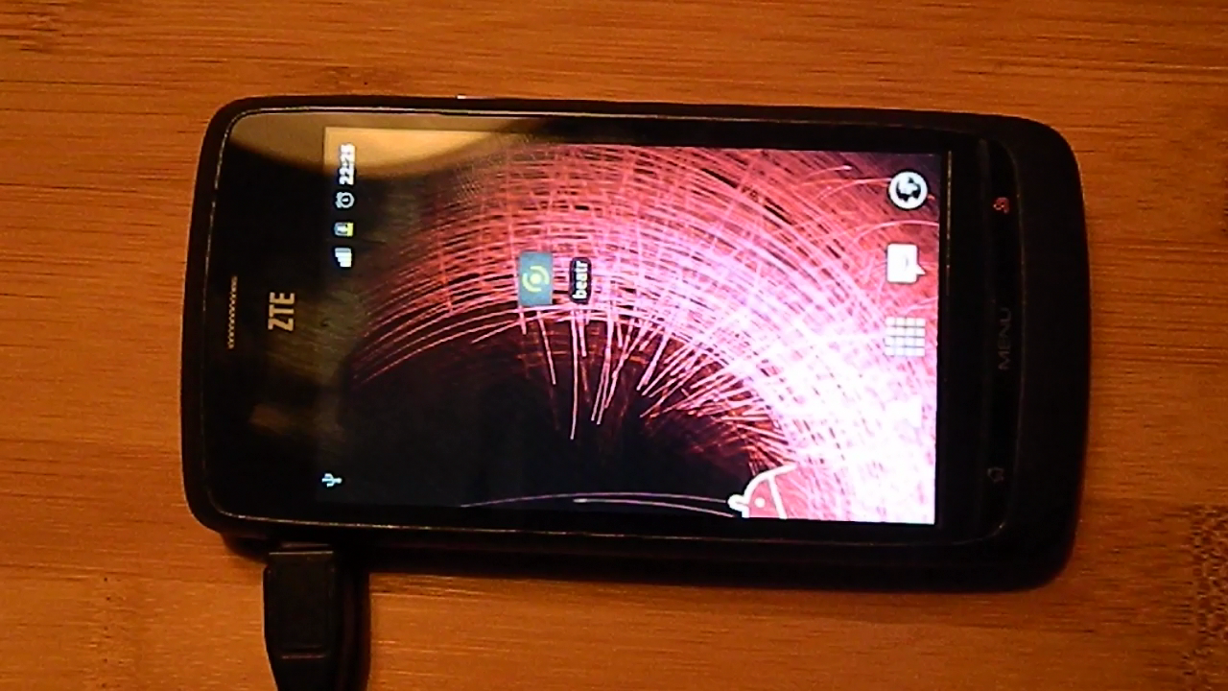
it’s demo time

Slide 9
3 key takeaways
+ if you are to develop an Android app, you
should probably use XML layouts. I didn’t and
I regret it. All layout properties are supported in
XML and it WILL reduce your lines of code
+ I’m happy I used an MVC approach. At first it felt like I wouldn’t need it. But when I approached 40+ classes, it was nice to have a standard of how to do things
+ as a programmer, you’ll not always have domain knowledge when you’re on a project. Important to make connections who have to help you with decision taking

Slide 10
thank you for listening!
feel free to download beatr
for Android from Google Play:
http://bit.ly/P7vTzo
(requires Android 2.3+)

